Slide 1
Data Gathering
Sara Muneeb
sara.muneeb@cuilahore.edu.pk
Computer Science Department

Slide 2

Data
Data can be numbers, words, measurements, descriptions, comments, photos, sketches, films, videos, or almost anything that is useful for understanding a particular design, user needs, and user behavior.
Data can be quantitative or qualitative.

Slide 3

Key Issues - Setting Goals
It is important to set specific goals for the study. These goals will influence the nature of
data gathering sessions
the data gathering techniques to be used, and the analysis to be performed
Goals should be clear and concise.

Slide 4

Key Issues - Identifying Participants
The goals developed for the data gathering session will indicate the types of people from whom data is to be gathered.
Those people who fit this profile are called the population or study population.

Slide 5
Sampling
Sampling: If participants to be included in data gathering need to be
chosen, and this is called sampling.
In general, having more participants is better because interpretations of statistical test results can be stated with higher confidence.
Most common size being 12.

Slide 6
Key Issues - Relationship with Participants
Consent
Personal Details
Special cases (people with disabilities and children)
Ethical considerations
Incentives

Slide 7
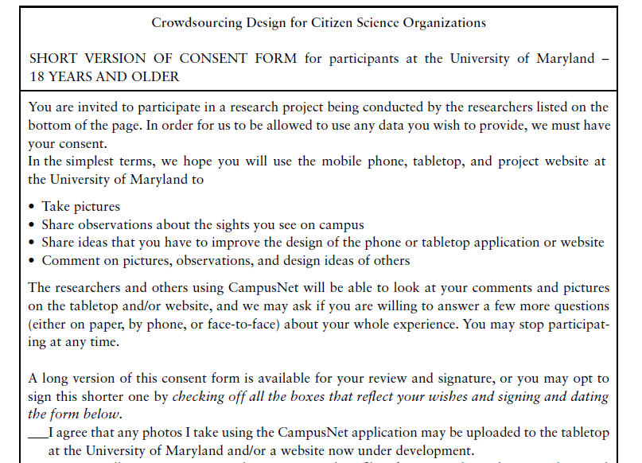
Sample Consent Form

Slide 8
Key Issues - Triangulations
Triangulation is a term used to refer to the investigation of a phenomenon from (at least) two different perspectives.
Different data gathering methods result in different kinds of data, which may or may not be compatible.

Slide 9
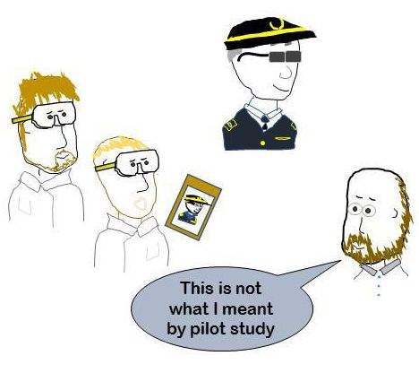
Key Issues - Pilot Study
A pilot study is a small trial run of the main study.
The aim is to make sure that the proposed
method is viable before embarking on the real study.
If it is difficult to find participants or access to them is limited, asking colleagues or peers to participate can work as an alternative for a pilot study.

Slide 10
Data , Information & Conclusion
There is an important difference between raw data, information, and conclusions.
Data is what you collect; this is then analyzed and interpreted, and conclusions drawn.
Information is gained from analyzing and interpreting the data and conclusions represent the actions to be taken based on the information.

Slide 11
Data Recording
Some forms of data gathering, such as questionnaires, diaries, interaction logging, scraping, and collecting work artifacts, are self-documenting and no further recording is necessary
The most common of these are taking notes, photographs, or recording audio
or video.

Slide 12
Notes & Photographs
Taking notes (by hand or by typing) is the least technical and most flexible way of recording data, even if it seems old-fashioned.
Handwritten notes may be transcribed in whole or in part.
It gives the analyst a good overview of the quality and contents of the data collected.

Slide 13
Disadvantages
it can be difficult to capture the right highlights
it can be tiring to write and listen or observe at the same time.
it is easy to lose concentration
biases creep in
handwriting can be difficult to decipher
And the speed of writing is limited.
Working with a colleague can reduce some of these problems while also providing another perspective.

Slide 14
Audios plus Photographs
Audio recording is a useful alternative to note-taking and is less intrusive than video.
It isn’t always necessary to transcribe all of the data collected—often only sections are needed, depending on the goals of the study.
Audio recordings are often supplemented with photographs.

Slide 15
Video
Deciding whether to fix the camera’s position or use a roving recorder.
Deciding where to point the camera in order to capture what is required.
Understanding the impact of the recording on participants.

Slide 16
Interviews
Interviews can be thought of as a “conversation with a purpose”
open-ended or unstructured
structured
semi-structured
group interviews
The most appropriate approach to interviewing depends on the purpose of the interview, the questions to be addressed, and the interaction design activity.

Slide 17
Unstructured Interviews

